Slide 1
Understanding Early-Stage Customer Churn: Insights and Strategies for Retention
By Kary Lam

Slide 2
Table of Contents
01 Data Overview
02 Customer Survival Analysis
03 Exploratory Data Analysis (EDA)
04 Modeling-Churn Prediction Model
05 Conclusion

Slide 3
Introduction
Why Does Churn Matter to Businesses?
Churn drives up acquisition costs, often costing 5 times more to gain a new customer than to retain one, making churn management essential for profitability and growth
What is Churn?
Churn is the rate at which customers stop doing business with a company over a specific period, impacting growth and profitability
How Can Data Analysis Help in Managing Churn?
Data analysis helps identify at-risk customers and predict churn, enabling targeted retention strategies to reduce churn and improve loyalty." more professional and specific
What Factors Contribute to Customer Churn???
How to reduce Churn??

Slide 4
Project Goals
What strategies can effectively leverage customer data insights to reduce churn, enhance retention, and drive sustainable growth?
Business Question
To analyze churn patterns and provide actionable strategies to reduce churn
Objective
Develop a predictive model that forecasts churn based on key factors, with a special focus on new customers with less than 24 months of tenure
Recommendation

Slide 5
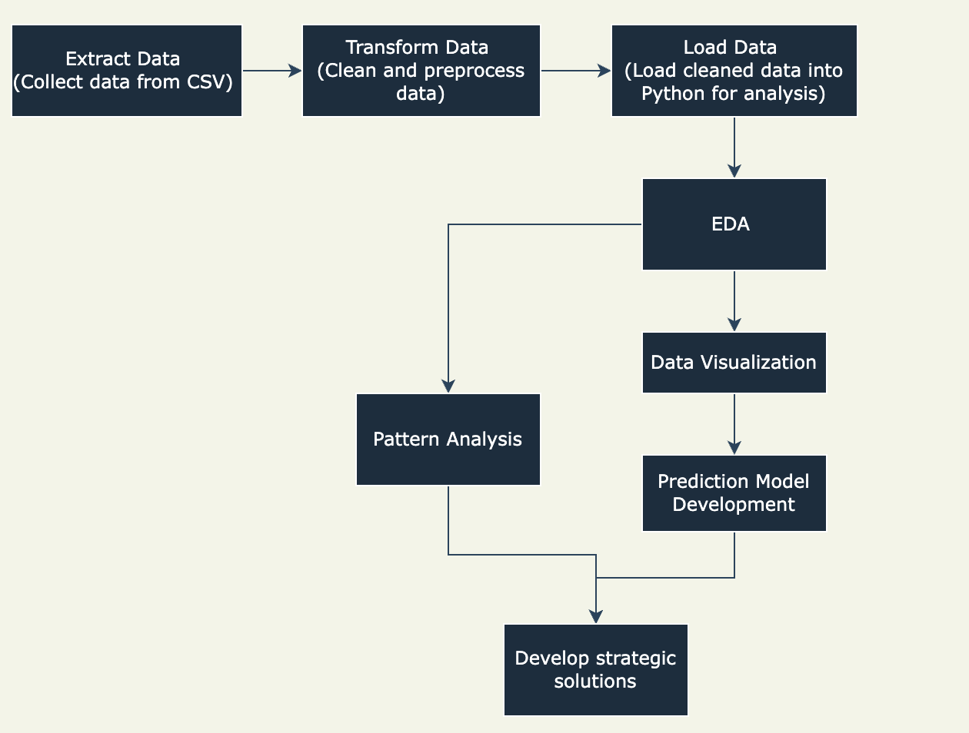
Project Flows

Slide 6
Data Overview - Dataset Attributes
Column Name | Description
customerID | Customer ID
gender | Whether the customer is a male or a female
SeniorCitizen | Whether the customer is a senior citizen or not (1, 0)
Partner | Whether the customer has a partner or not (Yes, No)
Dependents | Whether the customer has dependents or not (Yes, No)
tenure | Number of months the customer has stayed with the company
PhoneService | Whether the customer has a phone service or not (Yes, No)
MultipleLines | Whether the customer has multiple lines or not (Yes, No, No phone service)
InternetService | Customer’s internet service provider (DSL, Fiber optic, No)
OnlineSecurity | Whether the customer has online security or not (Yes, No, No internet service)
OnlineBackup | Whether the customer has online backup or not (Yes, No, No internet service)
Column Name | Description
DeviceProtection | Whether the customer has device protection or not (Yes, No, No internet service)
TechSupport | Whether the customer has tech support or not (Yes, No, No internet service)
StreamingTV | Whether the customer has streaming TV or not (Yes, No, No internet service)
StreamingMovies | Whether the customer has streaming movies or not (Yes, No, No internet service)
Contract | The contract term of the customer (Month-to-month, One year, Two year)
PaperlessBilling | Whether the customer has paperless billing or not (Yes, No)
PaymentMethod | The customer’s payment method (Electronic check, Mailed check, Bank transfer (automatic), Credit card (automatic))
MonthlyCharges | The amount charged to the customer monthly
TotalCharges | The total amount charged to the customer
Churn | Whether the customer churned or not (Yes or No)

Slide 7
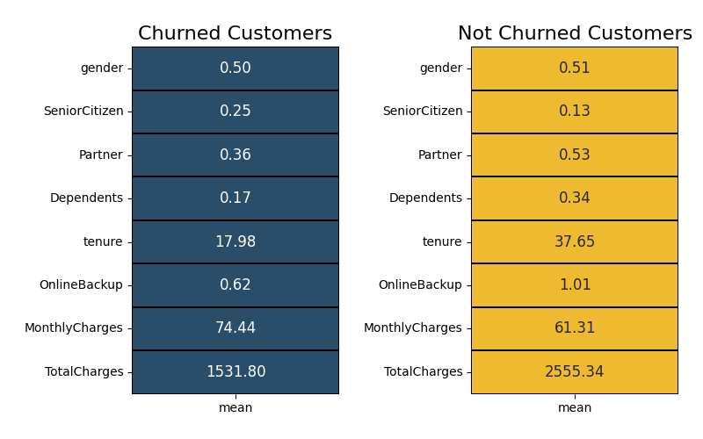
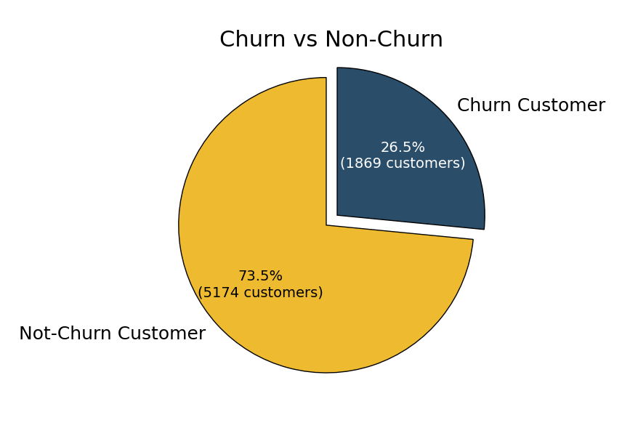
Data Overview - Descriptive Statistic
Churn Rate: Over one-quarter of the customer base (26.5%) has churned, indicating that a significant portion of customers might not be satisfied or are facing challenges that lead them to leave
Tenure: Churned customers stay 50% less time (17.98 months) compared to non-churned customers (37.57 months), suggesting that customers who leave typically do so within the first two years
Monthly Charges: Churned customers pay about 20% more monthly on average ($74.44) than non-churned customers ($61.27)
Total Charges: Non-churned customers spend 1.7 times more overall ($2557.31) than churned customers ($1531.80)

Slide 8
Exploratory Data Analysis (EDA)

Slide 9
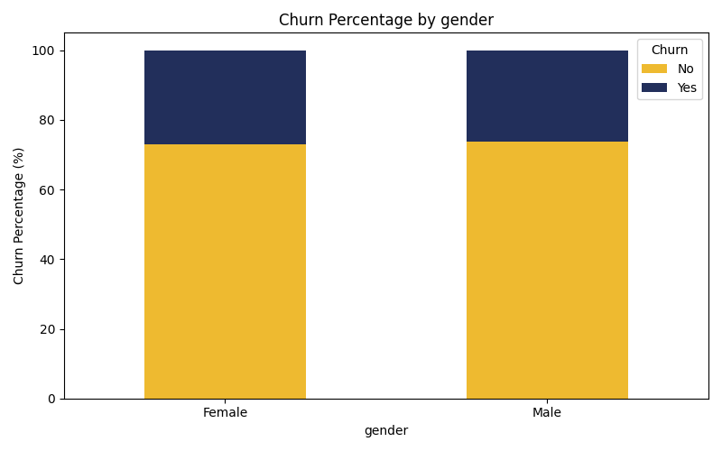
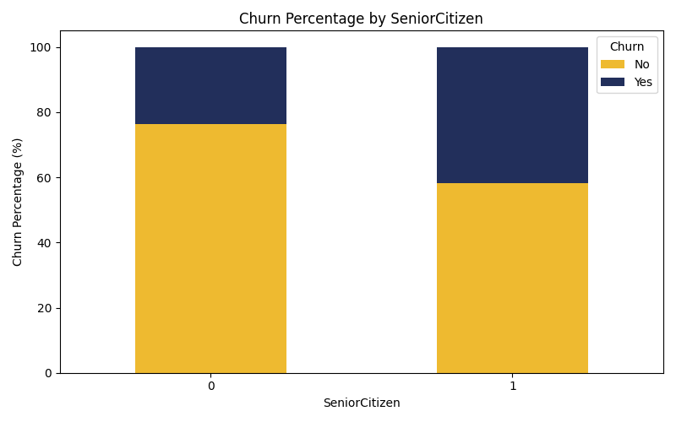
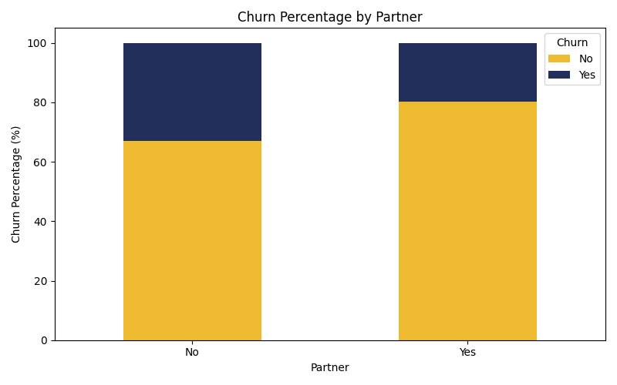
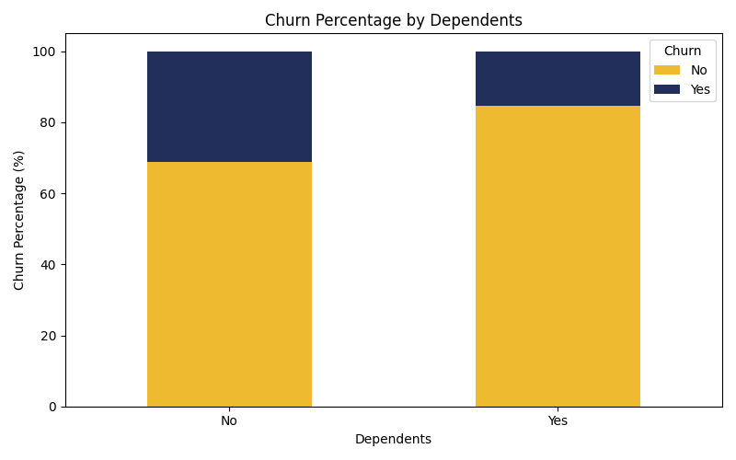
Customer Demographics
Gender alone is not a strong predictor of customer churn
Customers who are older, single, and without dependents are more likely to churn.
These insights suggest that targeted engagement strategies may be particularly effective for these high-risk group

Slide 10
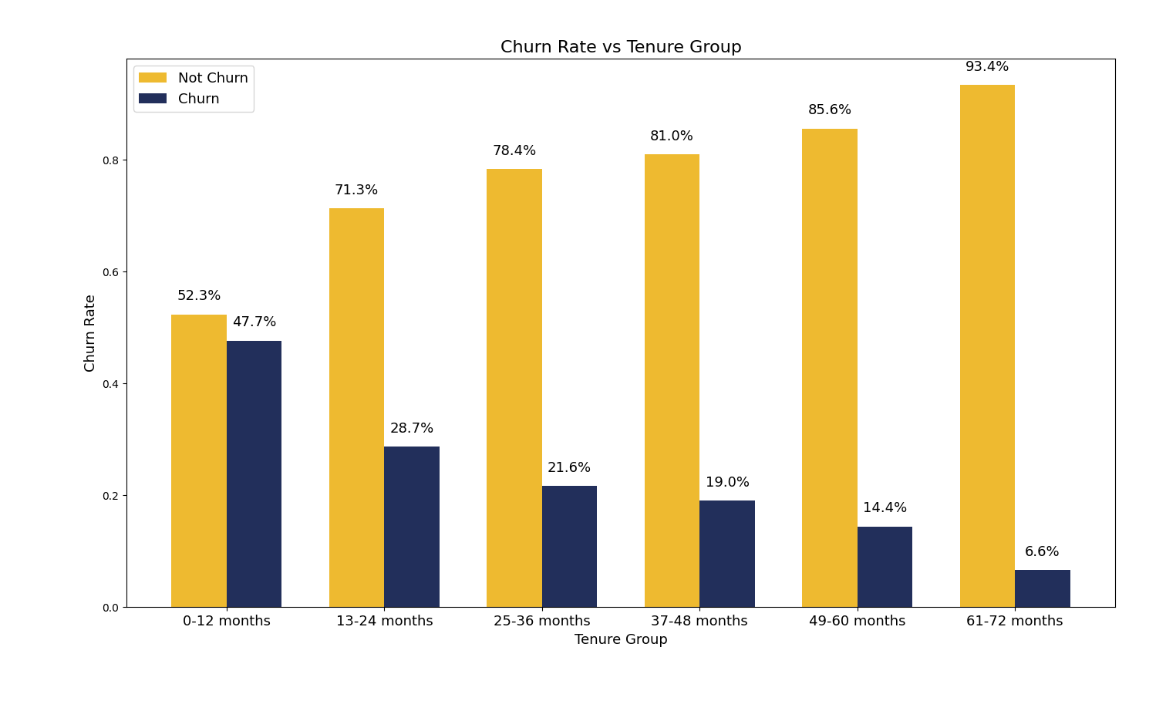
Customer Tenure & Churn Potential
Churn rates are highest in the first 12 months (47.7%) and decrease to 28.7% for customers in months 13-24. After 24 months, churn rates drop significantly, reaching just 6.6% by months 61-72.
This emphasizes the need for focused retention efforts within the first two years to improve long-term customer loyalty

Slide 11
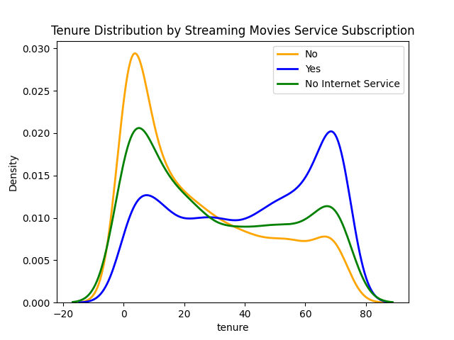

Service Subscription & Product Usage
Customers with streaming movie and TV subscriptions to have longer tenures compared to those without these services
New subscribers (<24 months) without streaming services show the highest churn rates
offering streaming options early may boost retention in the high-risk group

Slide 12
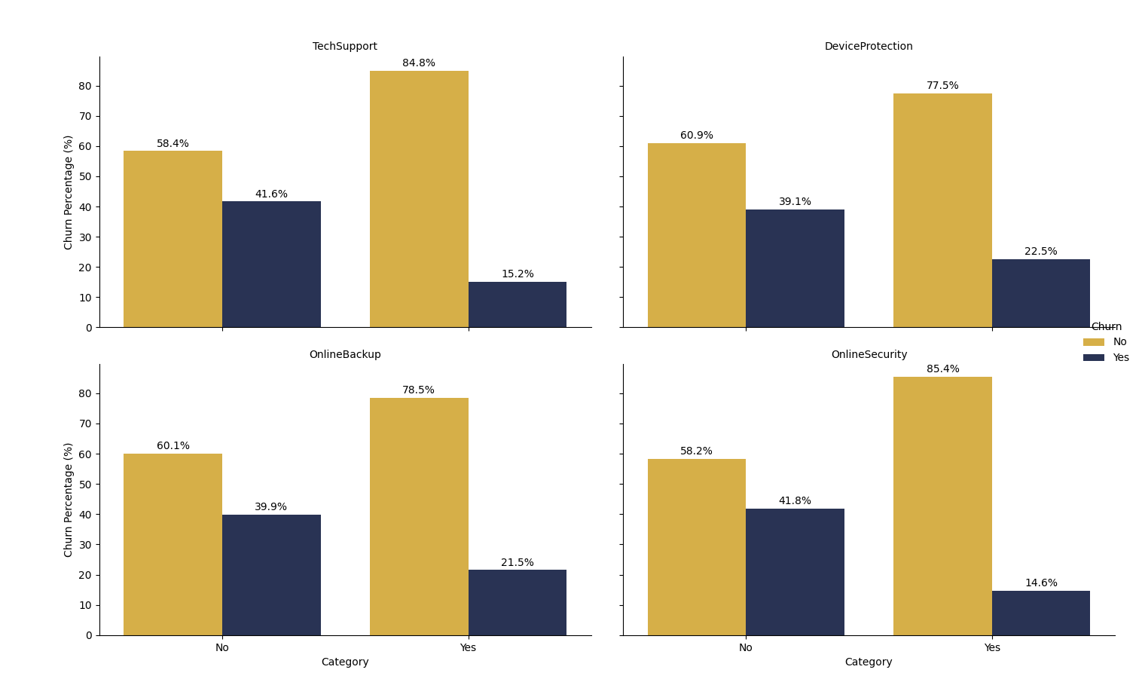
Service Subscription & Product Usage
Customers lacking tech support, device protection, online backup, or security services have significantly higher churn rates compared to those with these services
Actionable Strategy: Promote value-added services such as online security and tech support, especially to high-value customers, to enhance their service experience and improve retention.

Slide 13
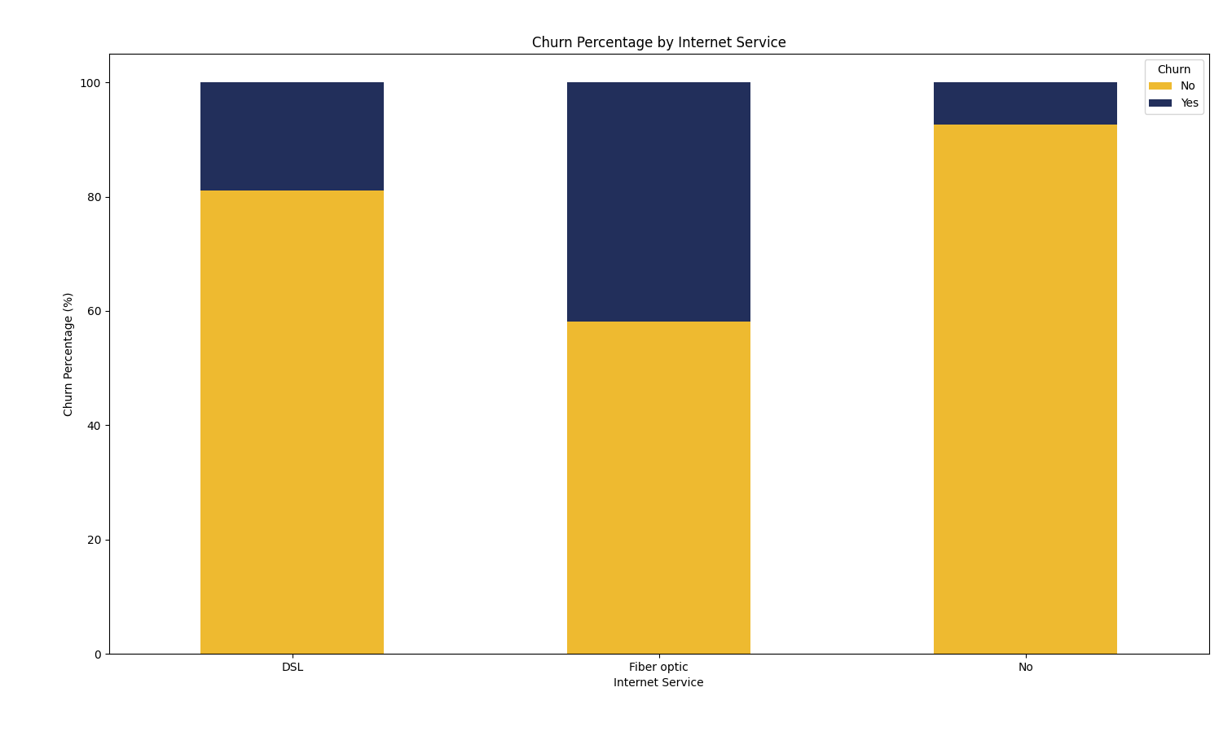
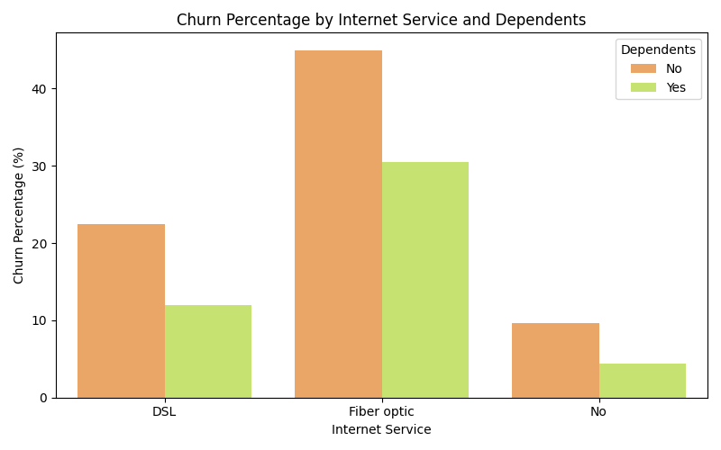
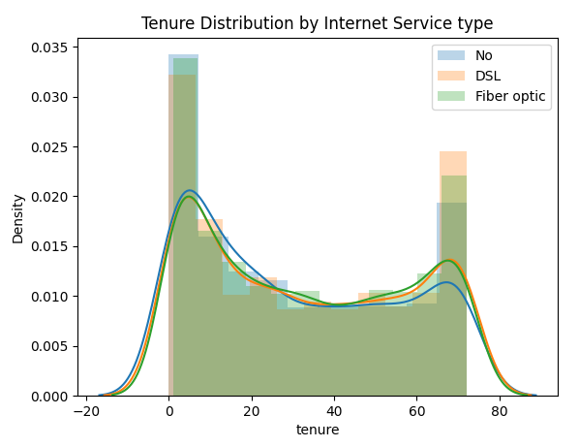
Fiber Optic Service Churn
High churn rate among Fiber Optic users, especially those without dependents
Indicates potential dissatisfaction with service quality or pricing
Retention Strategies
Improve Fiber Optic service quality and consider pricing adjustments
Offer targeted incentives for customers without dependents

Slide 14
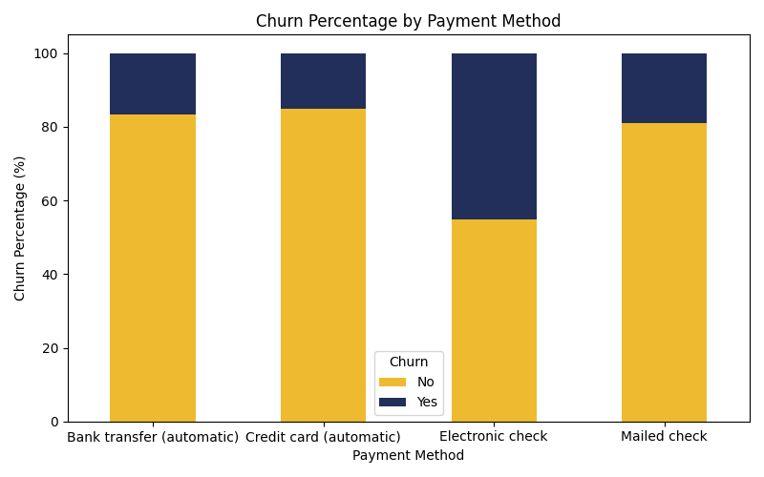
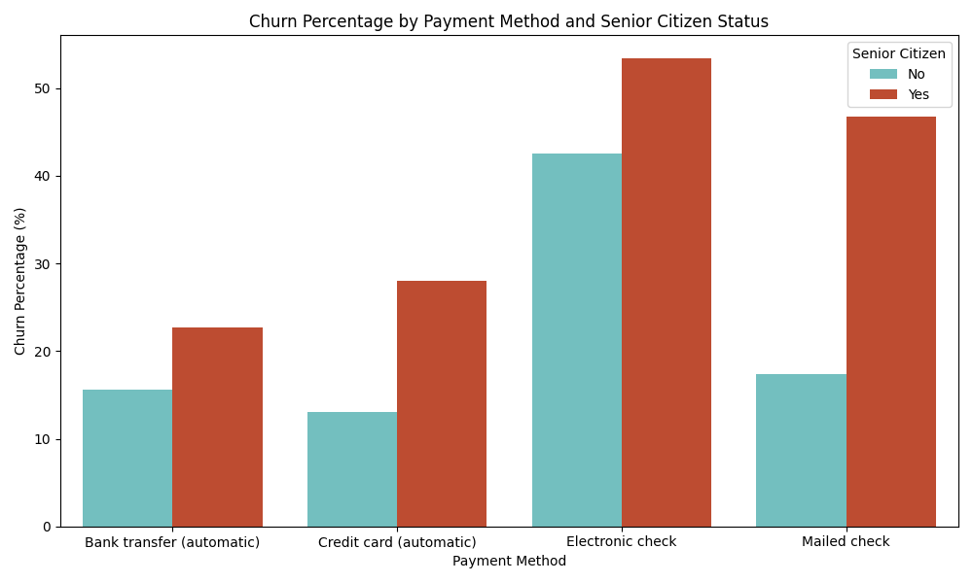
Billing & Payment Characteristics
Electronic Check: Highest churn rate, especially among senior citizens, suggesting dissatisfaction or inconvenience.
Mailed Check: High churn among senior citizens, signaling that this method may not support retention.
Automatic Payments (Bank Transfer, Credit Card): Lower churn, indicating preference for convenience.

Slide 15
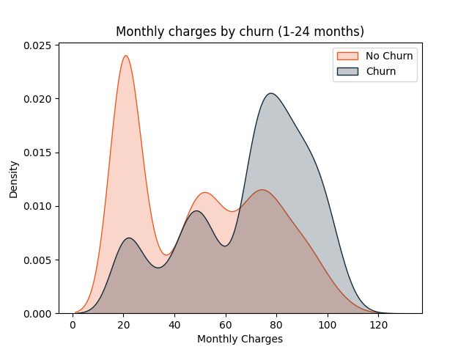
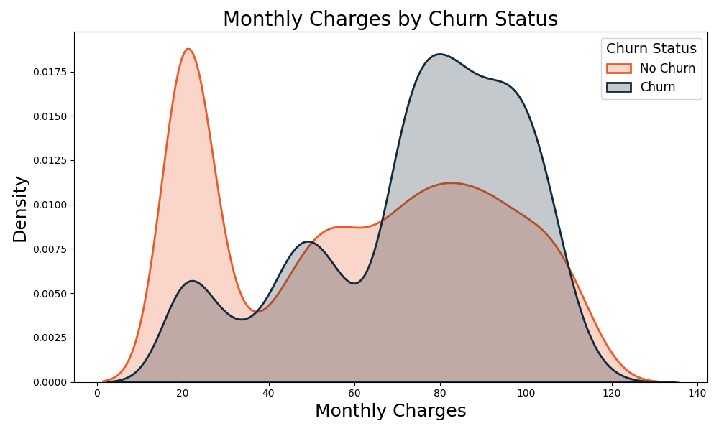
Billing & Payment Characteristics
High Monthly Charges Drive Churn: Churned customers generally have monthly charges above $70, especially within the first 24 months.
Early Tenure Sensitivity: New customers with higher charges are more likely to churn early.

Slide 16
EDA Summary
High-Risk Churn Group:
Customers who are older, single, and without dependents are more likely to churn
Fiber Optic users, especially those without dependents, exhibit high churn; improving service or offering targeted incentives could mitigate this
High-Risk Period:
Emphasize churn peaks within the first 12-24 months, underscoring the need for early engagement
Service-Specific Insights:
Billing Preferences & Spending Pattern:
Billing Preferences: Customers using electronic and mailed checks, particularly senior citizens, are more likely to churn. Encouraging automated payments could improve retention
Monthly Charges: Higher monthly charges correlate with higher churn rates, especially in the first two years. Addressing this with cost-sensitive offers could reduce churn
Customers without value-added service tech support or security services churn more, suggesting a focus on promoting value-added services
New subscribers (<24 months) without streaming services show the highest churn rates

Slide 17
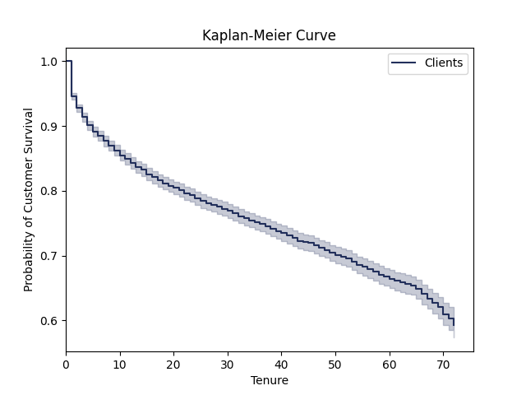
Customer Survival Analysis
The Kaplan-Meier curve reveals a sudden drop in retention after the first tenure period, with churn rates peaking in the early months (within the first 20 months) before gradually decreasing
This highlights a critical churn period where early engagement and support are essential
By identifying and addressing the main factors driving churn during this time, retention efforts can be more effective, helping to reduce customer loss and improve long-term loyalty.

Slide 18
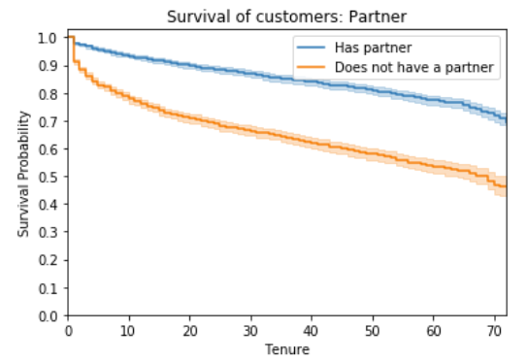
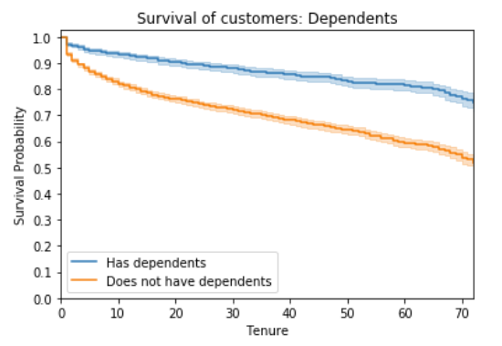
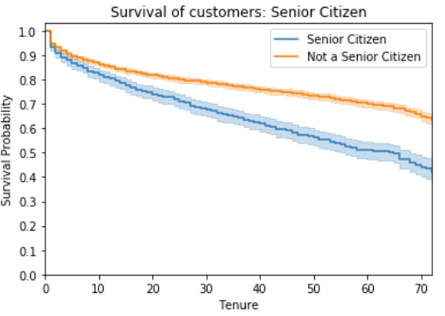
Customer's Gender and the phone service type are not indicative features and their p value of log rank test is above threshold value 0.05.
Senior customers without dependents and single are more likely to churn

Slide 19
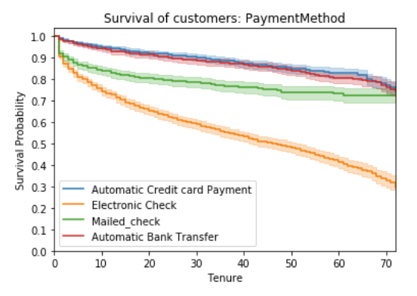
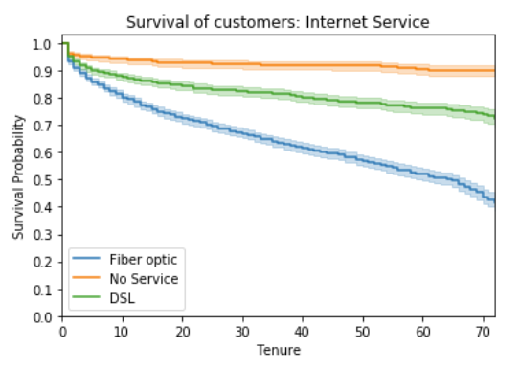
Customers with automatic payment methods are less likely to churn, as electronic and mailed check payments require more effort and time to complete.
The company should focus on retaining internet service users, whose survival probability consistently declines over time.
While Fiber Optic offers faster speeds than DSL, its higher costs may contribute to dissatisfaction, leading to a greater likelihood of customer churn compared to DSL users.

Slide 20
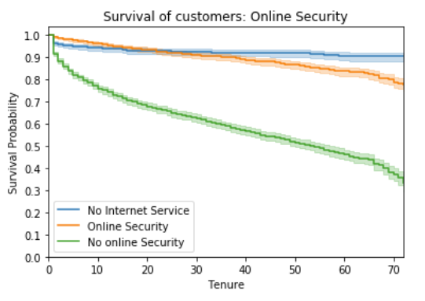
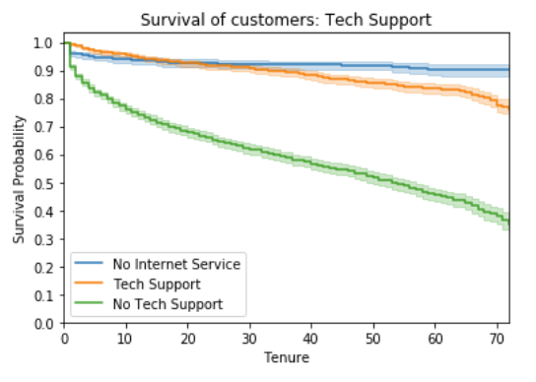
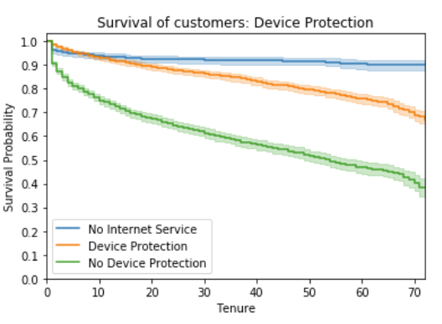
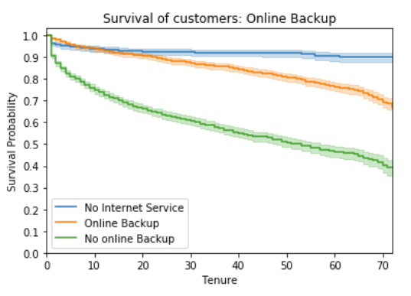

Slide 21
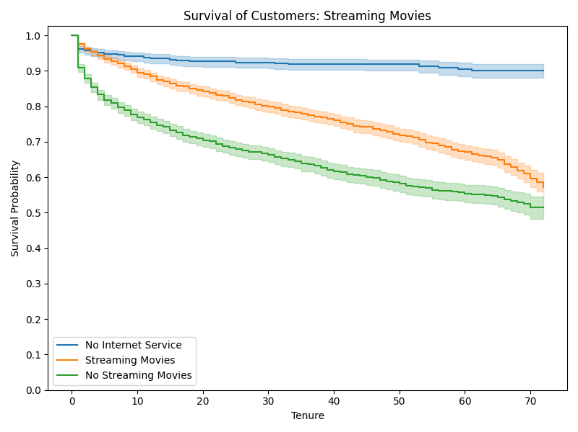
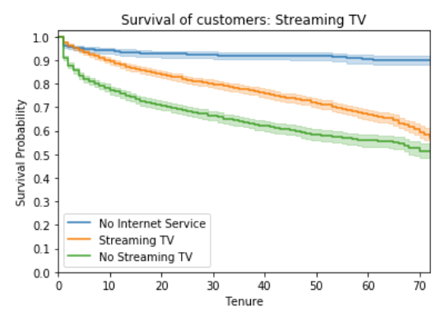
Customers with active internet service who do not subscribe to additional services like online backup, online security, device protection, tech support, streaming TV, or streaming movies have a lower survival probability.

Slide 22
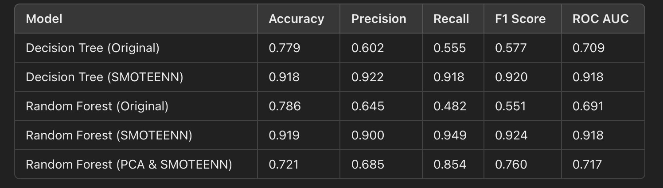
Prediction Model
Model Objective: To predict customer churn using machine learning models to help reduce the rate of churn by identifying at-risk customers.
Models Used: Decision Tree and Random Forest, which learn patterns in data to make predictions.
Data Balancing with SMOTEENN: Combined Synthetic Minority Oversampling (SMOTE) and Edited Nearest Neighbors (ENN) to improve balance and accuracy for the minority class (churn).
Dimensionality Reduction with PCA: Reduced data complexity by identifying key components, enhancing efficiency without sacrificing much information.
Performance Table: Show the results table with each model’s Accuracy, Precision, Recall, F1 Score, and ROC AUC scores.
Key Findings:
Models with SMOTEENN performed better on imbalanced data.
Random Forest models generally gave higher accuracy and F1 scores, especially with SMOTEENN and PCA.

Slide 23
Strategic Insights
Encourage Subscription to Value-Added Services:
Identify High-Risk Customers
2
Promote tech support, online security, and device protection to customers without these services. Discounts or bundled offers can be effective in improving retention by enhancing perceived value.
1
Use the Prediction Model
Focus on Top At-Risk Customers
Personalized Interventions
Incentivize Automatic Payments
Targeted Service Quality Improvements:
3
Offer discounts or convenience benefits for customers who switch to automatic payments, reducing churn related to payment friction.
4
Focus on Fiber Optic Service Quality: Investigate and address any service issues or price sensitivity for Fiber Optic customers, possibly through quality assurance measures or selective discounts.

Slide 24
End

